Slide 1
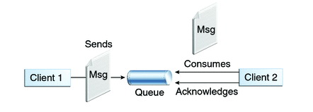

Spring Boot JMSTemplate with Embedded ActiveMQ
Queues [point-to-point]: Queue’s are based on point-to-point messaging model where messages are sent to a queue. Each message has exactly one sender and one receiver. Message is guaranteed to be delivered to only one receiver.
MessageProducerApplication.java
MessageReceiver.java

Slide 2
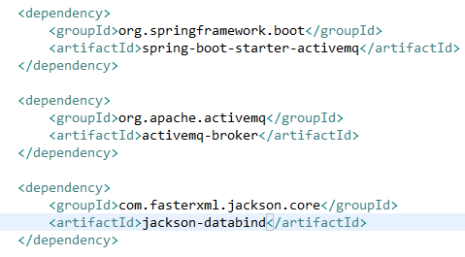
Spring Boot JMSTemplate with Embedded ActiveMQ
Update the pom.xml file with Spring Boot and ActiveMQ dependencies. Additionally, we will need Jackson for object to JSON conversion.

Slide 3
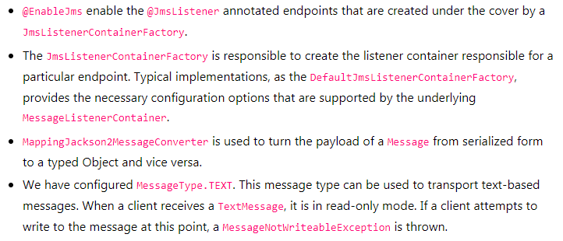
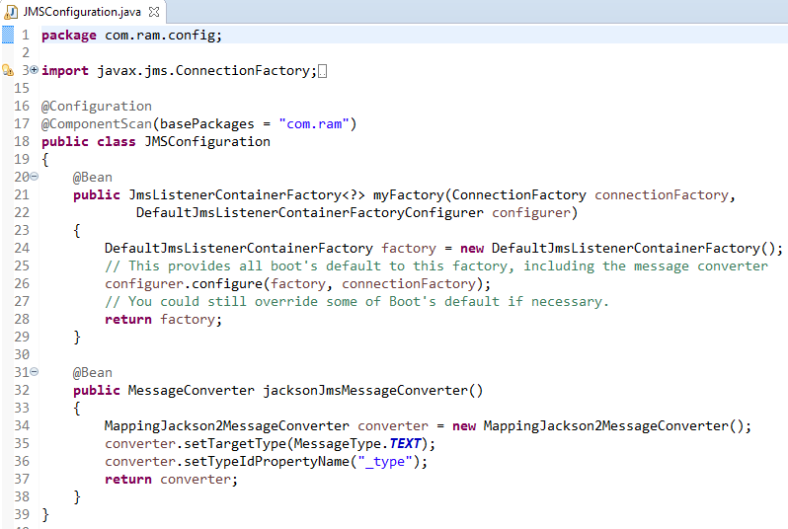
Spring Boot JMSTemplate with Embedded ActiveMQ

Slide 4
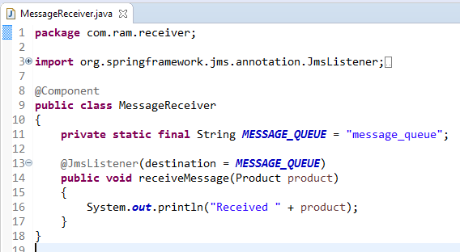
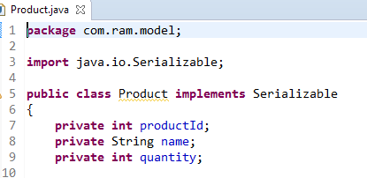
Spring Boot JMSTemplate with Embedded ActiveMQ
Message receiver class is pretty much simple class with single method with annotation @JmsListener. @JmsListener allows you to expose a method of a managed bean as a JMS listener endpoint.
So whenever any message is available on configured queue (in this example queue name is “message_queue”), annotated method (i.e. receiveMessage) will be invoked.

Slide 5
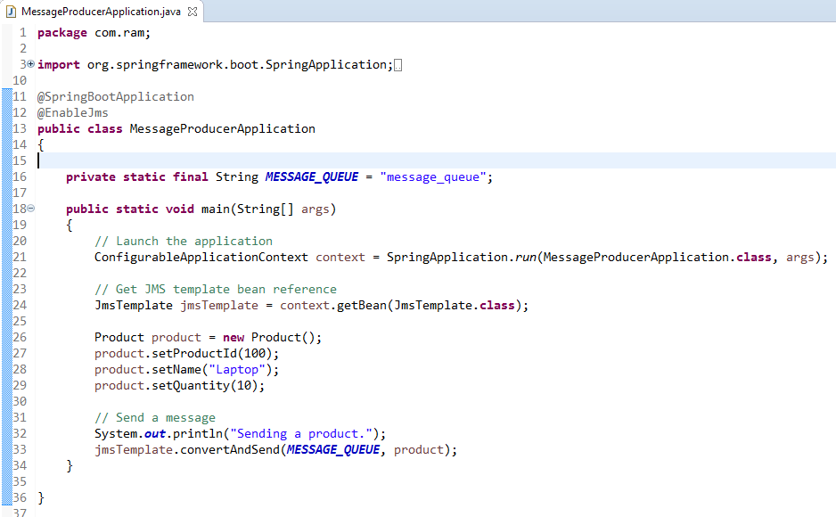
Spring Boot JMSTemplate with Embedded ActiveMQ

